Slide 1
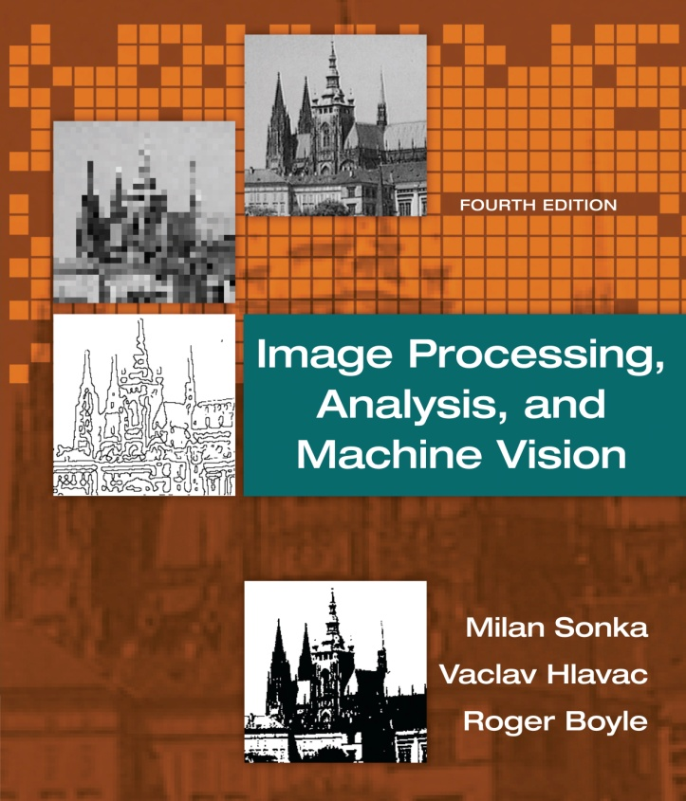

Chapter 13
Image Processing, Analysis, and Machine Vision, 4th Edition Sonka, Hlavac & Boyle
Mathematical morphology

Slide 2
Mathematical morphology
Image Processing, Analysis, and Machine Vision, 4th Edition Sonka, Hlavac & Boyle
Basic morphological concepts
Four morphological principles
Binary dilation and erosion
Gray-scale dilation and erosion
Skeletons and object marking
Granulometry
Morphological segmentation and watersheds

Slide 3
Basic morphological concepts
Image Processing, Analysis, and Machine Vision, 4th Edition Sonka, Hlavac & Boyle
Morphological operations are used for the following purposes:
Image pre-processing
Noise filtering, shape simplification
Enhancing object structure
Skeletonizing, thinning, thickening, convex hull
Segmenting objects from the background
Quantitative description of objects
Area, perimeter projections

Slide 4
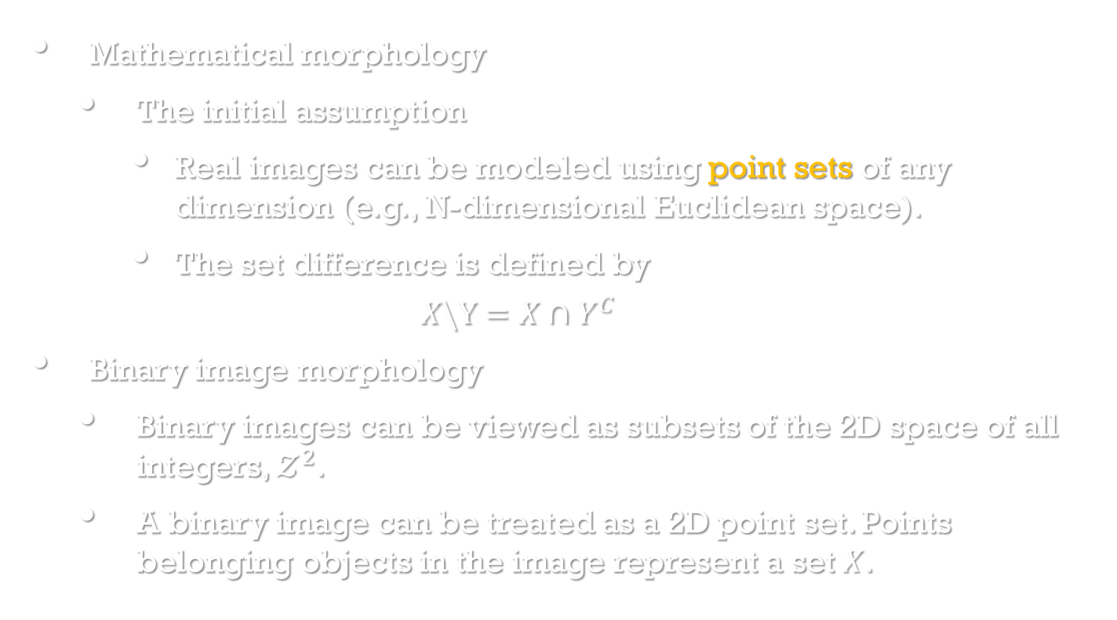
Basic morphological concepts
Image Processing, Analysis, and Machine Vision, 4th Edition Sonka, Hlavac & Boyle
Mathematical morphology
The initial assumption
Real images can be modeled using point sets of any dimension (e.g., N-dimensional Euclidean space).
The set difference is defined by
$$X\backslash Y=X∩Y^{C}$$
Binary image morphology
Binary images can be viewed as subsets of the 2D space of all integers, $𝒵^{2}$.
A binary image can be treated as a 2D point set. Points belonging objects in the image represent a set $X$.

Slide 5
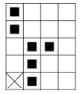
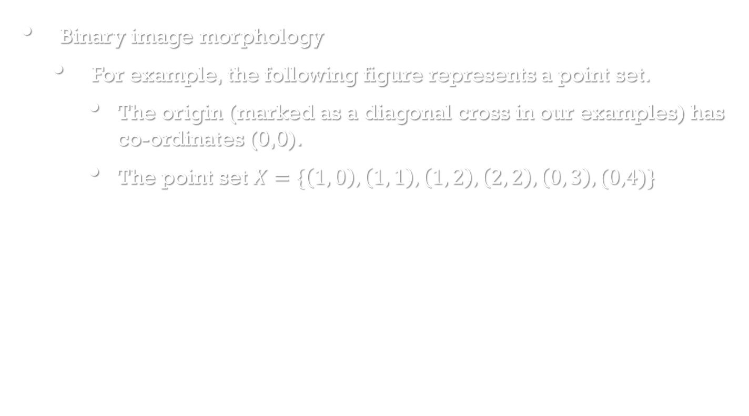
Basic morphological concepts
Image Processing, Analysis, and Machine Vision, 4th Edition Sonka, Hlavac & Boyle
Binary image morphology
For example, the following figure represents a point set.
The origin (marked as a diagonal cross in our examples) has co-ordinates (0,0).
The point set $X=\{\left(1, 0\right),\left(1, 1\right),\left(1, 2\right), \left(2, 2\right), \left(0, 3\right),(0,4)\}$

Slide 6
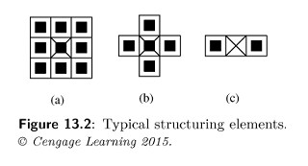
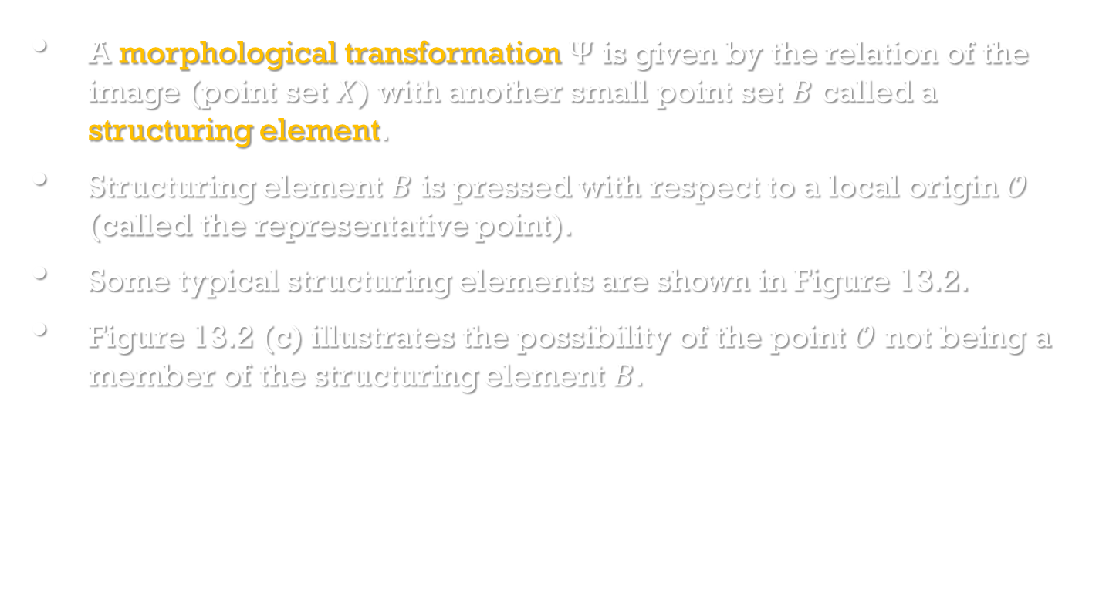
Basic morphological concepts
Image Processing, Analysis, and Machine Vision, 4th Edition Sonka, Hlavac & Boyle
A morphological transformation $Ψ$ is given by the relation of the image (point set $X$) with another small point set $B$ called a structuring element.
Structuring element $B$ is pressed with respect to a local origin $𝒪$ (called the representative point).
Some typical structuring elements are shown in Figure 13.2.
Figure 13.2 (c) illustrates the possibility of the point $𝒪$ not being a member of the structuring element $B$.

Slide 7
Basic morphological concepts
Image Processing, Analysis, and Machine Vision, 4th Edition Sonka, Hlavac & Boyle
A morphological transformation $Ψ$ is given by the relation of the image (point set $X$) with another small point set $B$ called a structuring element.
Structuring element $B$ is pressed with respect to a local origin $𝒪$ (called the representative point).
Some typical structuring elements are shown in Figure 13.2.
Figure 13.2 (c) illustrates the possibility of the point $𝒪$ not being a member of the structuring element $B$.

Slide 8
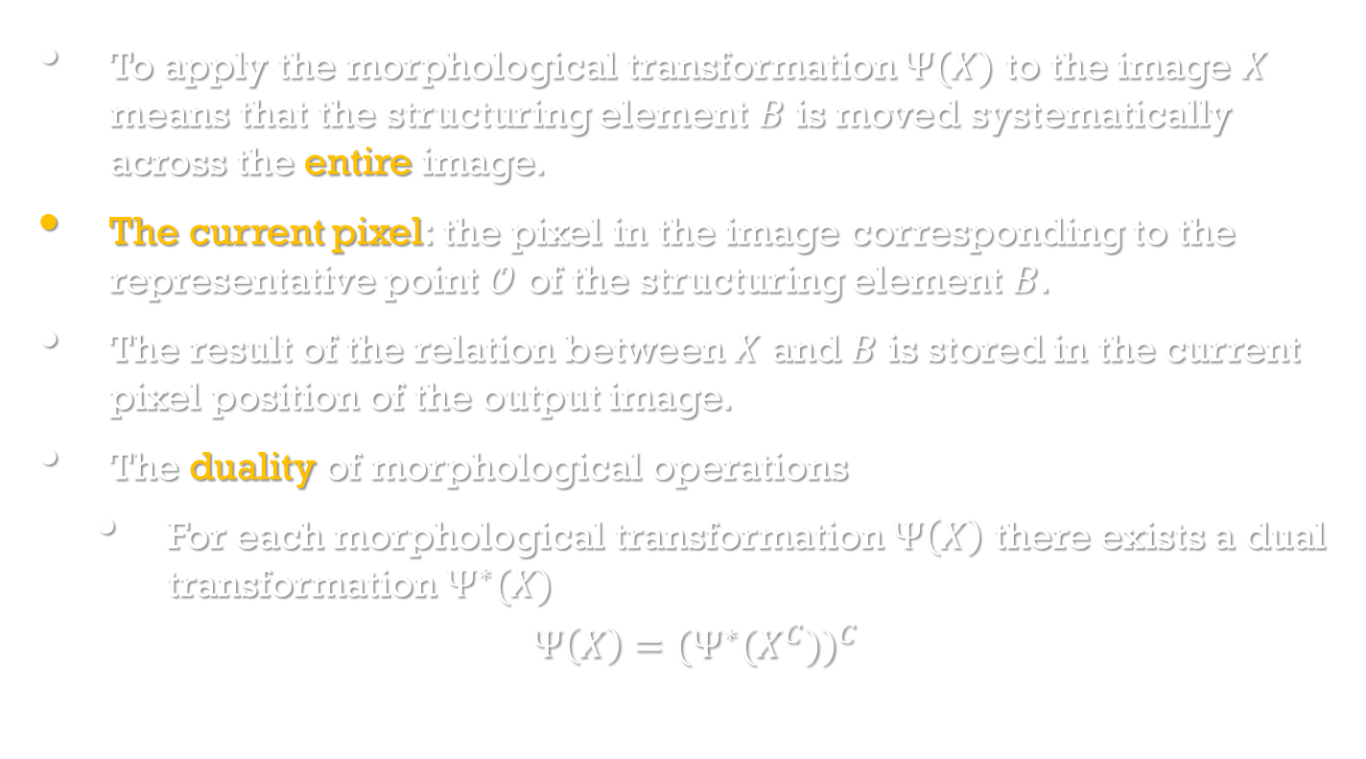
Basic morphological concepts
Image Processing, Analysis, and Machine Vision, 4th Edition Sonka, Hlavac & Boyle
To apply the morphological transformation $Ψ(X)$ to the image $X$ means that the structuring element $B$ is moved systematically across the entire image.
The current pixel: the pixel in the image corresponding to the representative point $𝒪$ of the structuring element $B$.
The result of the relation between $X$ and $B$ is stored in the current pixel position of the output image.
The duality of morphological operations
For each morphological transformation $Ψ\left(X\right)$ there exists a dual transformation $Ψ^{∗}(X)$
$$Ψ\left(X\right)={(Ψ^{∗}(X^{C}))}^{C}$$

Slide 9
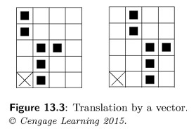
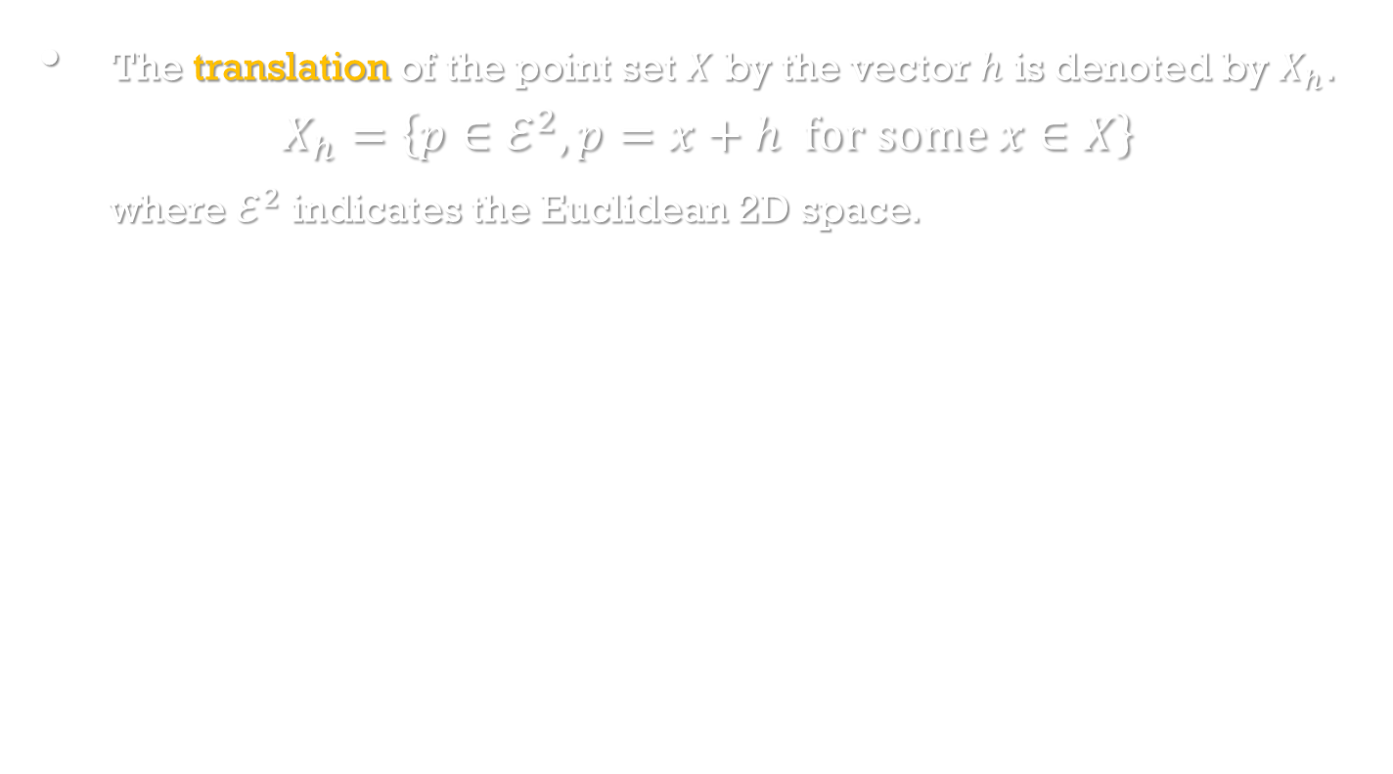
Basic morphological concepts
Image Processing, Analysis, and Machine Vision, 4th Edition Sonka, Hlavac & Boyle
The translation of the point set $X$ by the vector $h$ is denoted by $X_{h}$.
$$X_{h}=\left\{p∈ℰ^{2},p=x+h for some x∈X\right\}$$
where $ℰ^{2}$ indicates the Euclidean 2D space.

Slide 10
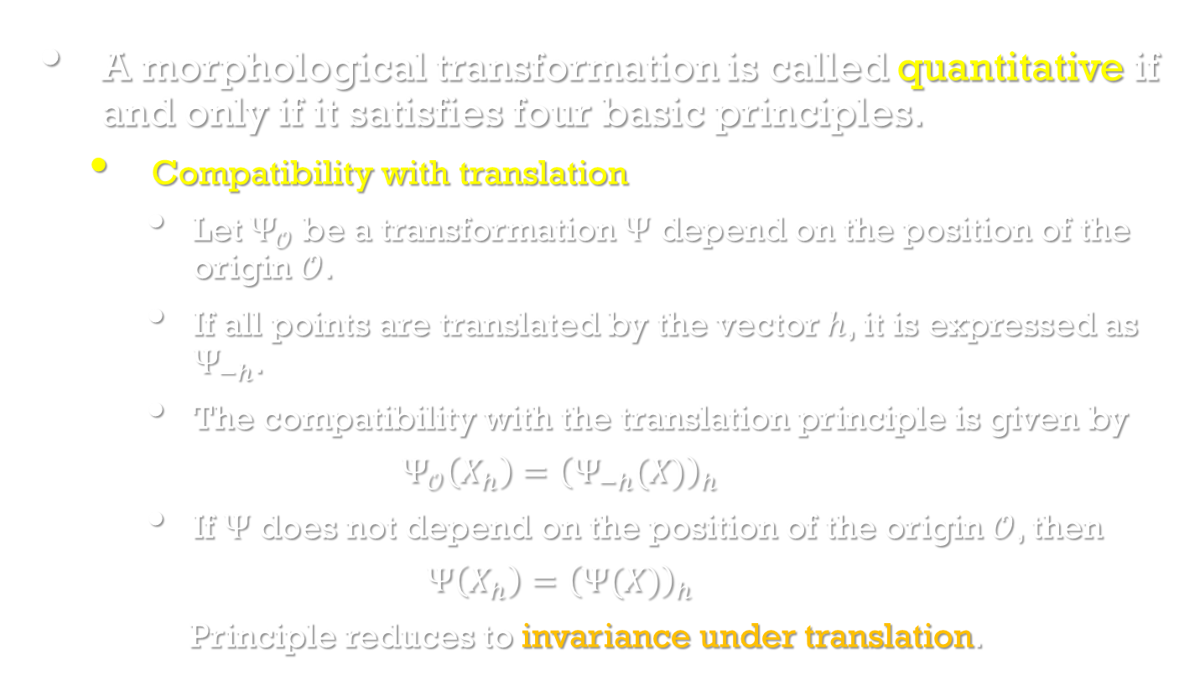
Four Morphological principles
Image Processing, Analysis, and Machine Vision, 4th Edition Sonka, Hlavac & Boyle
A morphological transformation is called quantitative if and only if it satisfies four basic principles.
Compatibility with translation
Let $Ψ_{𝒪}$ be a transformation $Ψ$ depend on the position of the origin $𝒪$.
If all points are translated by the vector $h$, it is expressed as $Ψ_{−h}$.
The compatibility with the translation principle is given by
$$Ψ_{𝒪}\left(X_{h}\right)={\left(Ψ_{−h}(X)\right)}_{h}$$
If $Ψ$ does not depend on the position of the origin $𝒪$, then
$$Ψ\left(X_{h}\right)={\left(Ψ(X)\right)}_{h}$$
Principle reduces to invariance under translation.

Slide 11
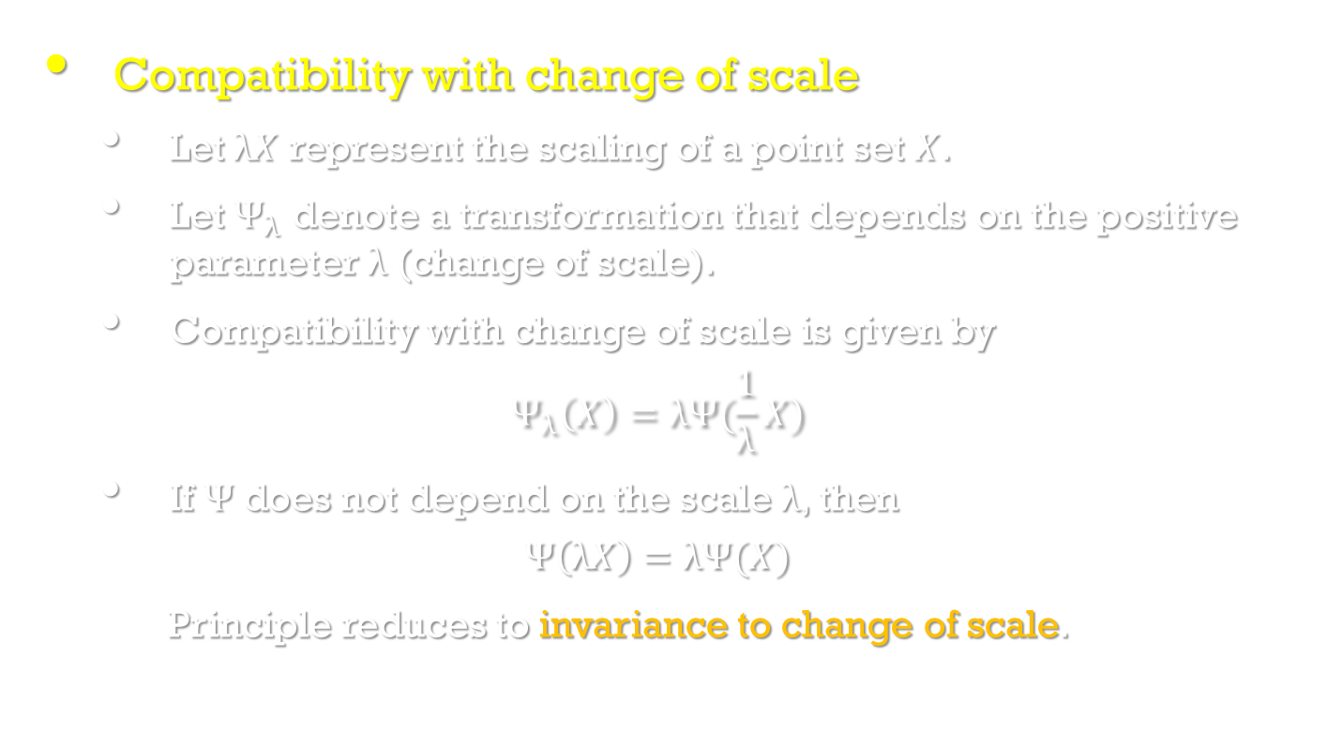
Four Morphological principles
Image Processing, Analysis, and Machine Vision, 4th Edition Sonka, Hlavac & Boyle
Compatibility with change of scale
Let $λX$ represent the scaling of a point set $X$.
Let $Ψ_{λ}$ denote a transformation that depends on the positive parameter $λ$ (change of scale).
Compatibility with change of scale is given by
$$Ψ_{λ}\left(X\right)=λΨ(\frac{1}{λ}X)$$
If $Ψ$ does not depend on the scale $λ$, then
$$Ψ\left(λX\right)=λΨ(X)$$
Principle reduces to invariance to change of scale.

Slide 12
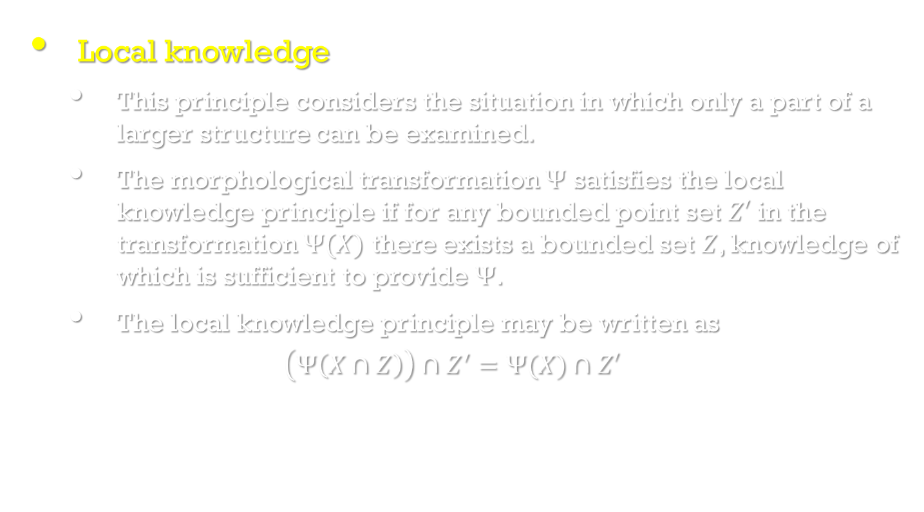
Four Morphological principles
Image Processing, Analysis, and Machine Vision, 4th Edition Sonka, Hlavac & Boyle
Local knowledge
This principle considers the situation in which only a part of a larger structure can be examined.
The morphological transformation $Ψ$ satisfies the local knowledge principle if for any bounded point set $Z′$ in the transformation $Ψ(X)$ there exists a bounded set $Z$, knowledge of which is sufficient to provide $Ψ$.
The local knowledge principle may be written as
$$\left(Ψ\left(X∩Z\right)\right)∩Z^{′}=Ψ(X)∩Z′$$

Slide 13
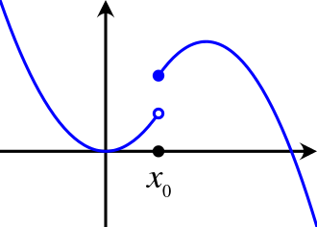
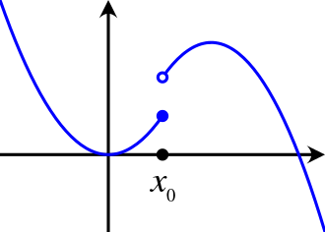
Four Morphological principles
Image Processing, Analysis, and Machine Vision, 4th Edition Sonka, Hlavac & Boyle
Upper semi-continuity
The upper semi-continuity says that the morphological transformation does not exhibit any abrupt (意外的) changes.
A precise explanation is given in [Serra,1982].
An upper semi-continuous function. The solid blue dot indicates f(x₀).
A lower semi-continuous function. The solid blue dot indicates f(x₀).
https://en.wikipedia.org/wiki/Semi-continuity

Slide 14
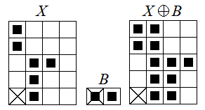
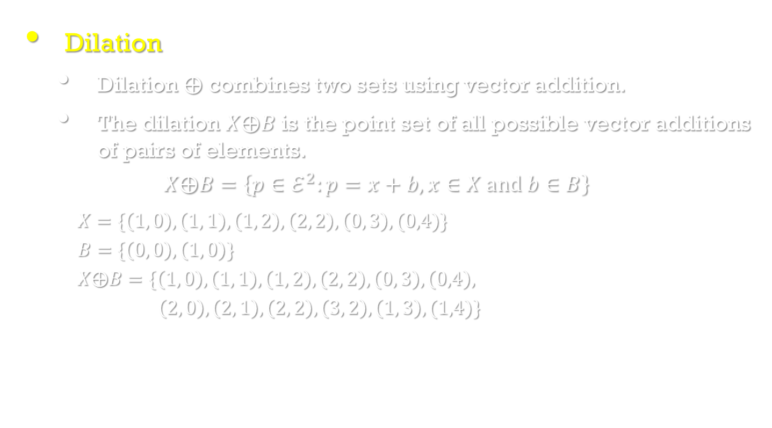
Binary dilation and erosion
Image Processing, Analysis, and Machine Vision, 4th Edition Sonka, Hlavac & Boyle
Dilation
Dilation $⨁$ combines two sets using vector addition.
The dilation $X⨁B$ is the point set of all possible vector additions of pairs of elements.
$$X⨁B=\left\{p∈ℰ^{2}:p=x+b, x∈X and b∈B\right\}$$
$X=\{\left(1, 0\right),\left(1, 1\right),\left(1, 2\right), \left(2, 2\right), \left(0, 3\right),(0,4)\}$
$B=\{\left(0, 0\right),\left(1, 0\right)\}$
$X⨁B=\{\left(1, 0\right),\left(1, 1\right),\left(1, 2\right), \left(2, 2\right), \left(0, 3\right),\left(0,4\right),$
$\left(2, 0\right),\left(2, 1\right),\left(2, 2\right), \left(3, 2\right), \left(1, 3\right),(1,4)\}$

Slide 15
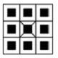

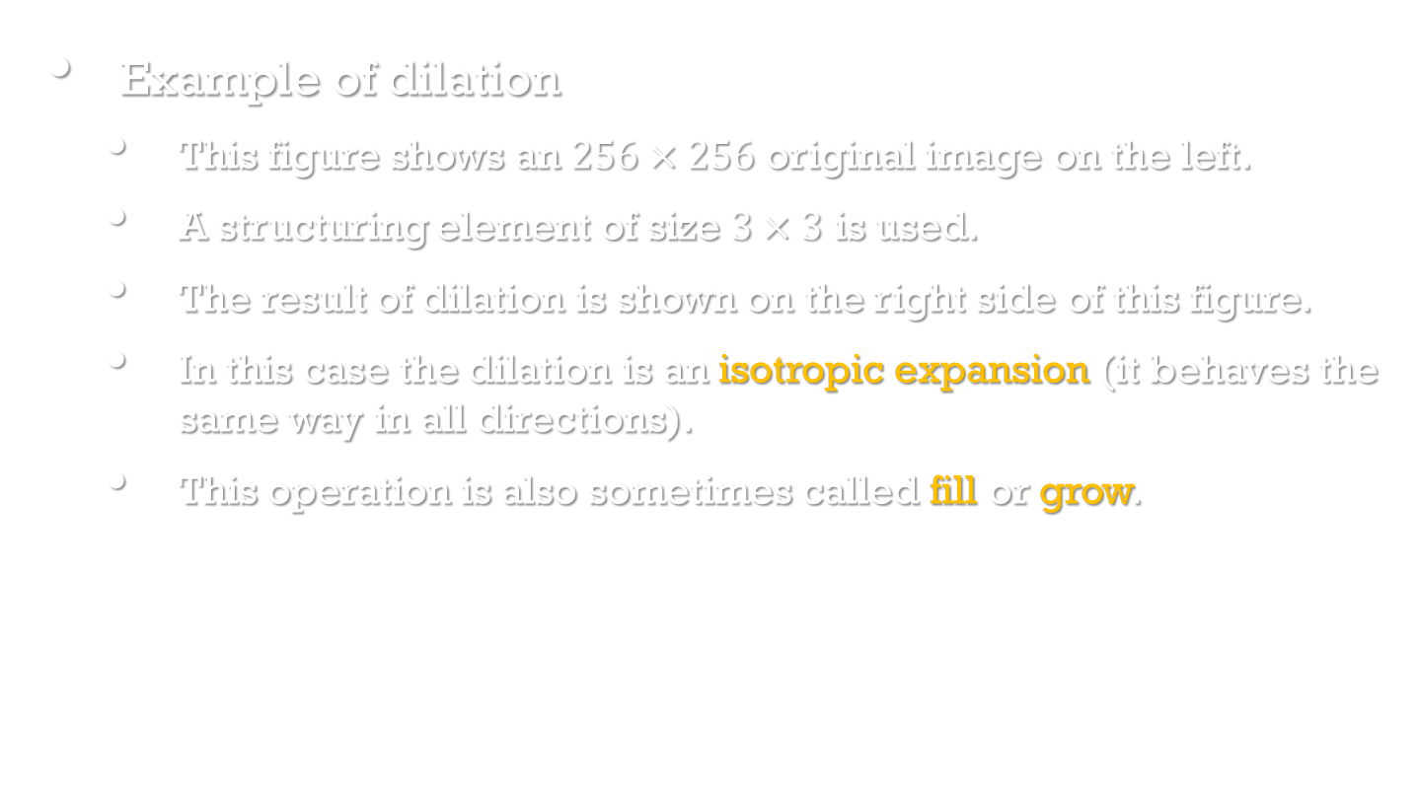
Binary dilation and erosion
Image Processing, Analysis, and Machine Vision, 4th Edition Sonka, Hlavac & Boyle
Example of dilation
This figure shows an $256×256$ original image on the left.
A structuring element of size $3×3$ is used.
The result of dilation is shown on the right side of this figure.
In this case the dilation is an isotropic expansion (it behaves the same way in all directions).
This operation is also sometimes called fill or grow.

Slide 16
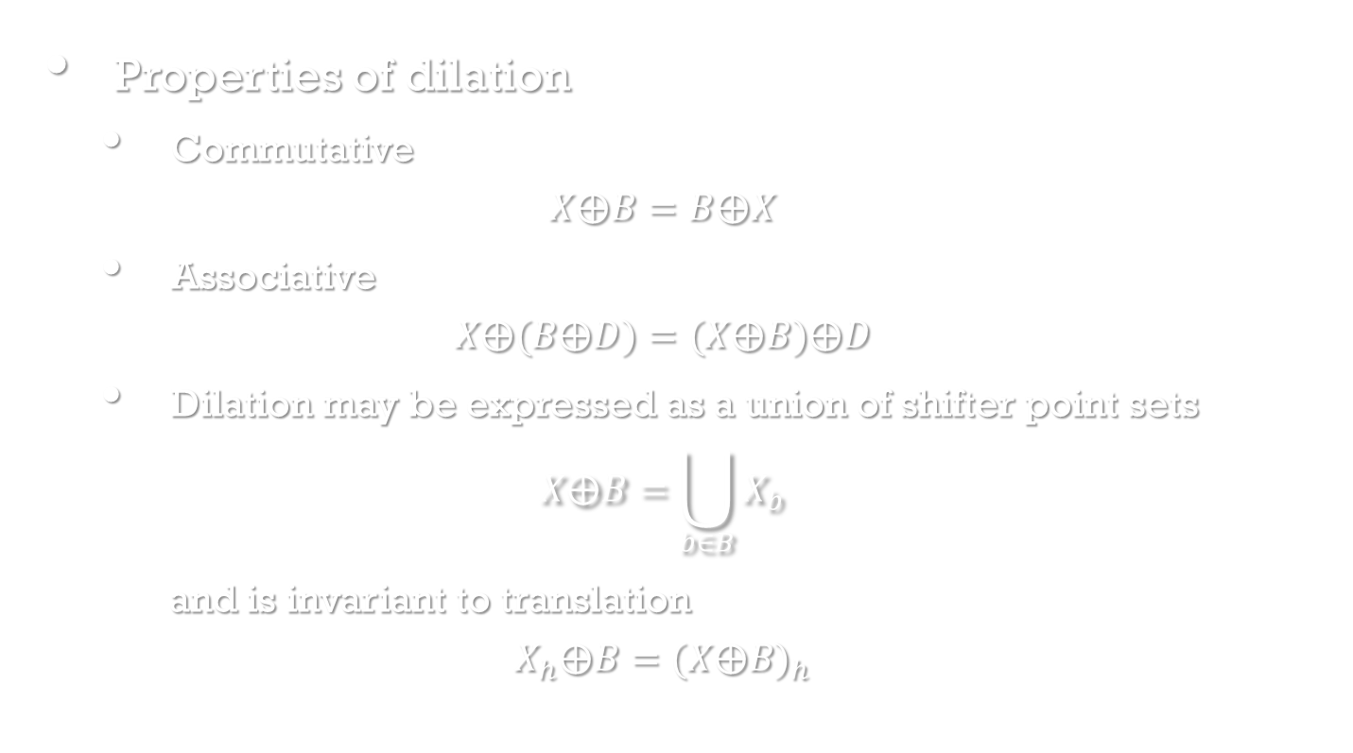
Binary dilation and erosion
Image Processing, Analysis, and Machine Vision, 4th Edition Sonka, Hlavac & Boyle
Properties of dilation
Commutative
$$X⨁B=B⨁X$$
Associative
$$X⨁(B⨁D)=(X⨁B)⨁D$$
Dilation may be expressed as a union of shifter point sets
$$X⨁B=\bigcup_{b∈B}{X_{b}}$$
and is invariant to translation
$$X_{h}⨁B={(X⨁B)}_{h}$$

Slide 17
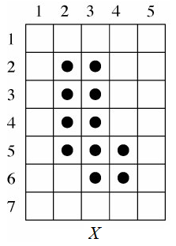
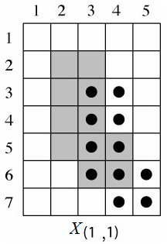
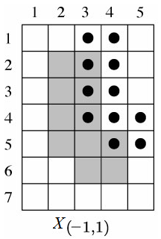
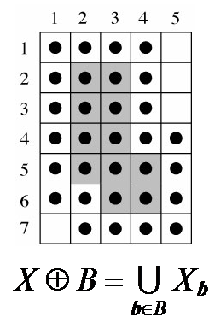
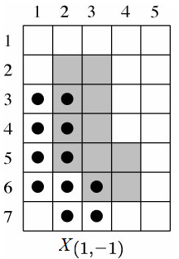
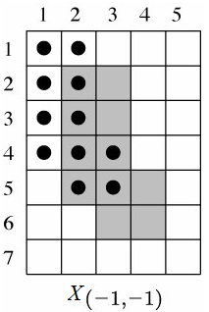
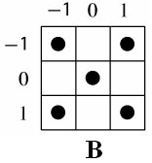

Slide 18
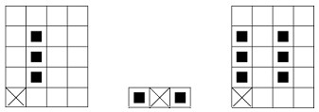
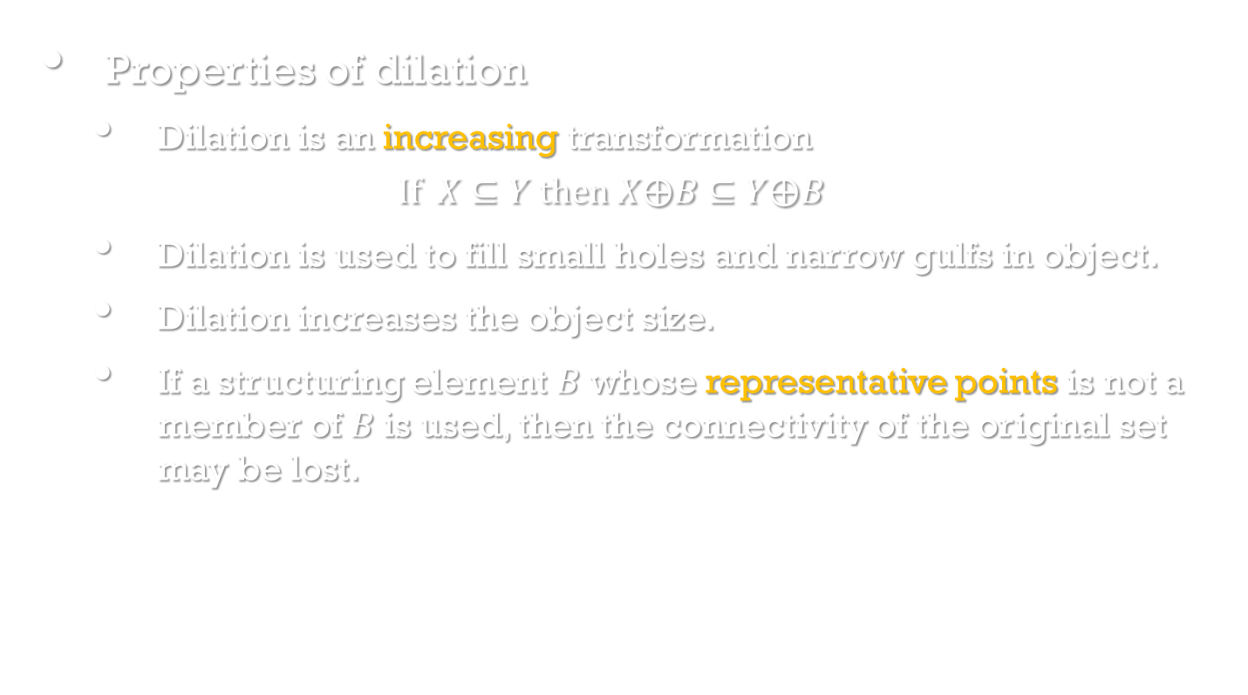
Binary dilation and erosion
Image Processing, Analysis, and Machine Vision, 4th Edition Sonka, Hlavac & Boyle
Properties of dilation
Dilation is an increasing transformation
$$If X⊆Y then X⨁B⊆Y⨁B$$
Dilation is used to fill small holes and narrow gulfs in object.
Dilation increases the object size.
If a structuring element $B$ whose representative points is not a member of $B$is used, then the connectivity of the original set may be lost.

Slide 19
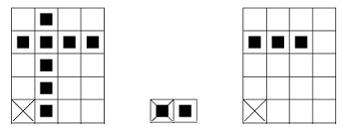
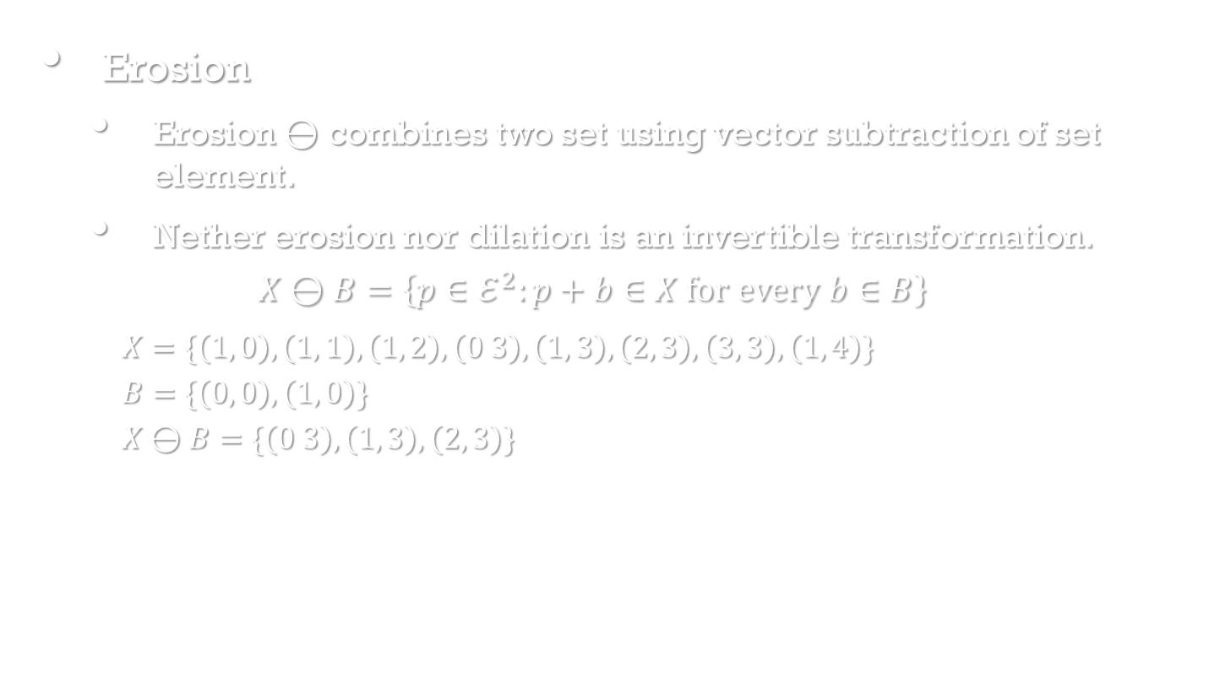
Binary dilation and erosion
Image Processing, Analysis, and Machine Vision, 4th Edition Sonka, Hlavac & Boyle
Erosion
Erosion $⊖$ combines two set using vector subtraction of set element.
Nether erosion nor dilation is an invertible transformation.
$$X⊖B=\left\{p∈ℰ^{2}:p+b∈X for every b∈B\right\}$$
$X=\{\left(1, 0\right),\left(1, 1\right),\left(1, 2\right),\left(0 3\right),\left(1, 3\right),\left(2, 3\right),\left(3, 3\right), \left(1, 4\right)\}$
$B=\{\left(0, 0\right),\left(1, 0\right)\}$
$X⊖B=\{\left(0 3\right),\left(1, 3\right),\left(2, 3\right)\}$

Slide 20

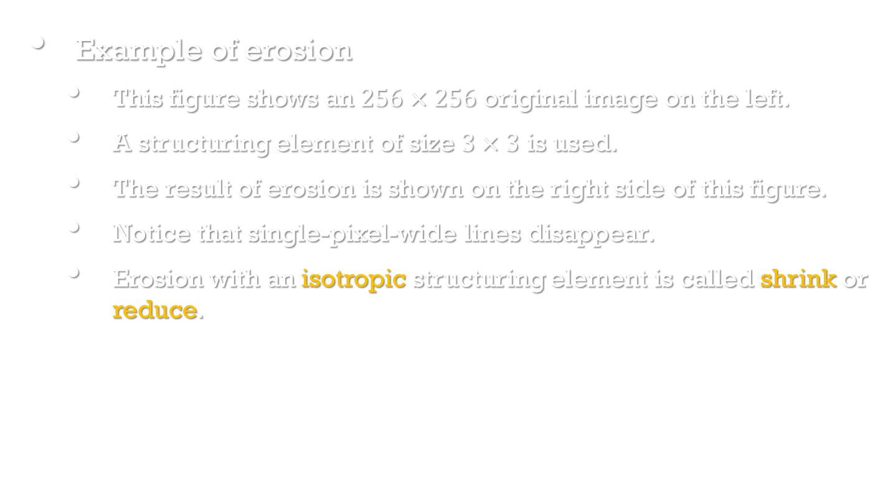
Binary dilation and erosion
Image Processing, Analysis, and Machine Vision, 4th Edition Sonka, Hlavac & Boyle
Example of erosion
This figure shows an $256×256$ original image on the left.
A structuring element of size $3×3$ is used.
The result of erosion is shown on the right side of this figure.
Notice that single-pixel-wide lines disappear.
Erosion with an isotropic structuring element is called shrink or reduce.

Slide 21

Binary dilation and erosion
Image Processing, Analysis, and Machine Vision, 4th Edition Sonka, Hlavac & Boyle
Basic morphological transformations can be used to find the contours of objects in an image very quickly.
For example, subtracting from the original picture of its eroded version.
Erosion is used to simplify the structure of an object.
It may decompose complicated objects into several simpler ones.

Slide 22
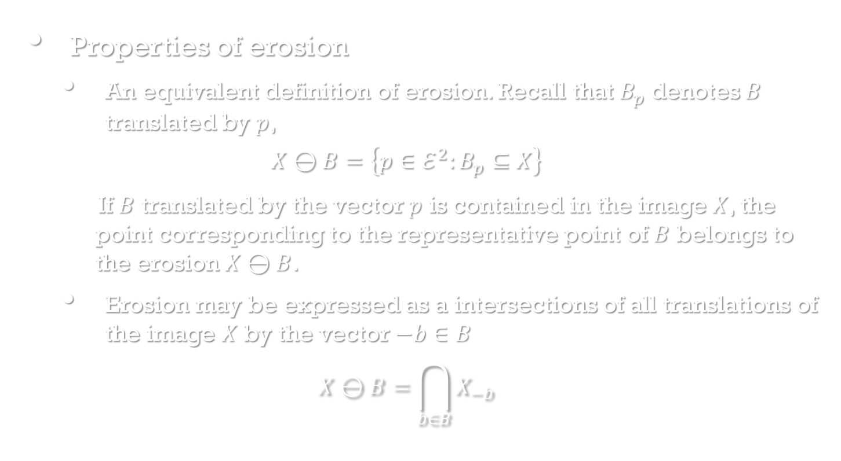
Binary dilation and erosion
Image Processing, Analysis, and Machine Vision, 4th Edition Sonka, Hlavac & Boyle
Properties of erosion
An equivalent definition of erosion. Recall that $B_{p}$ denotes $B$ translated by $p$,
$$X⊖B=\left\{p∈ℰ^{2}:B_{p}⊆X\right\}$$
If $B$ translated by the vector $p$ is contained in the image $X$, the point corresponding to the representative point of $B$ belongs to the erosion $X⊖B$.
Erosion may be expressed as a intersections of all translations of the image $X$ by the vector $−b∈B$
$$X⊖B=\bigcap_{b∈B}{X_{−b}}$$

Slide 23
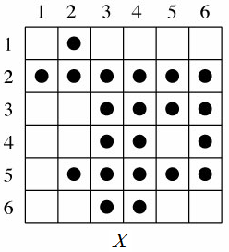
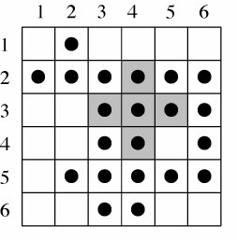
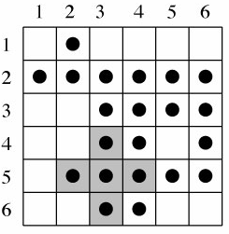
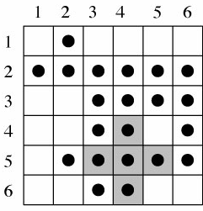
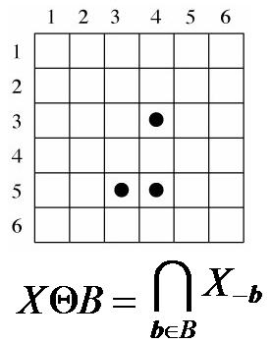
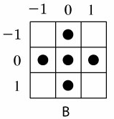
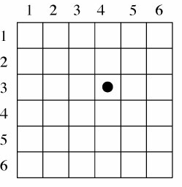
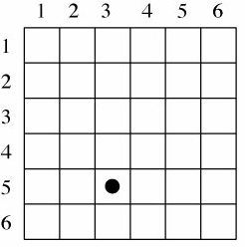
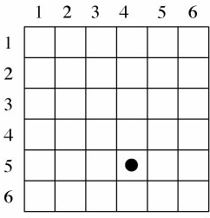
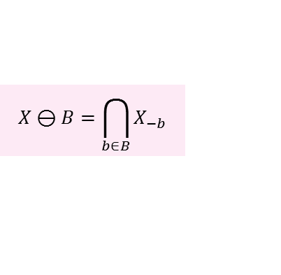
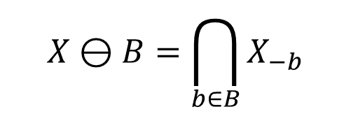
$$X⊖B=\bigcap_{b∈B}{X_{−b}}$$
$$X⊖B=\bigcap_{b∈B}{X_{−b}}$$

Slide 24
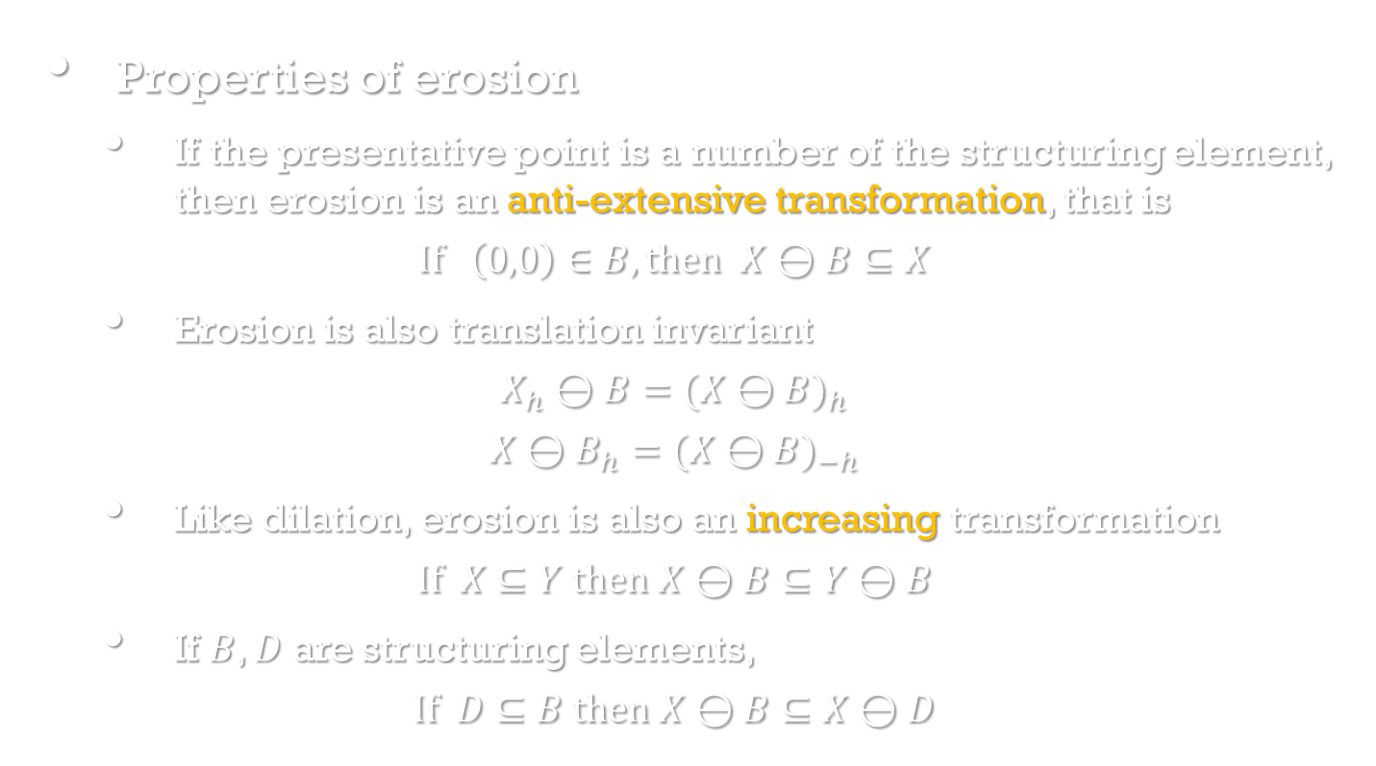
Binary dilation and erosion
Image Processing, Analysis, and Machine Vision, 4th Edition Sonka, Hlavac & Boyle
Properties of erosion
If the presentative point is a number of the structuring element, then erosion is an anti-extensive transformation, that is
$$If \left(0,0\right)∈B, then X⊖B⊆X$$
Erosion is also translation invariant
$$X_{h}⊖B={(X⊖B)}_{h}$$
$$X⊖B_{h}={(X⊖B)}_{−h}$$
Like dilation, erosion is also an increasing transformation
$$If X⊆Y then X⊖B⊆Y⊖B$$
If $B$, $D$ are structuring elements,
$$If D⊆B then X⊖B⊆X⊖D$$

Slide 25
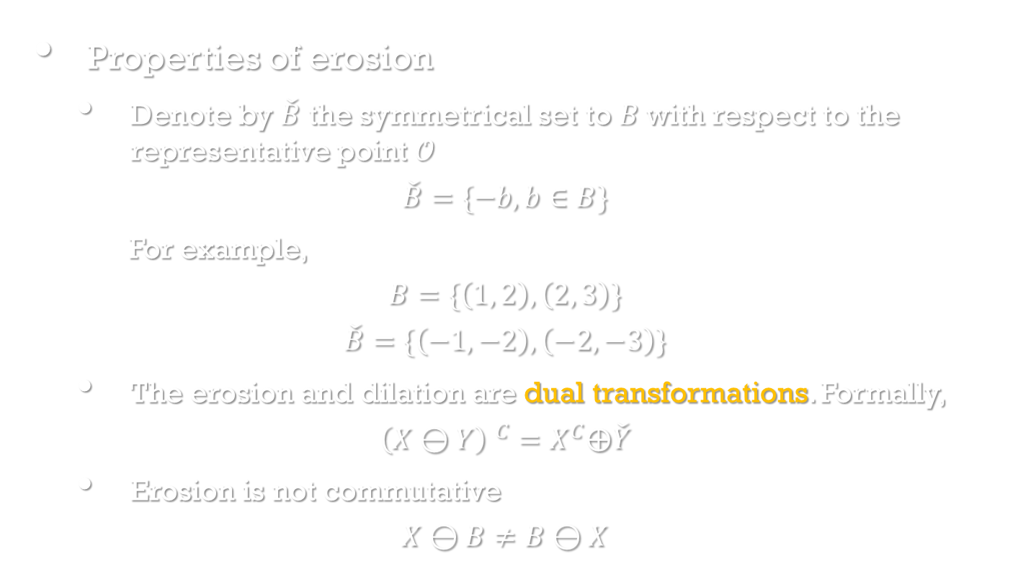
Binary dilation and erosion
Image Processing, Analysis, and Machine Vision, 4th Edition Sonka, Hlavac & Boyle
Properties of erosion
Denote by $\check{B}$ the symmetrical set to $B$with respect to the representative point $𝒪$
$$\check{B}=\{−b,b∈B\}$$
For example,
$$B=\{\left(1, 2\right),\left(2, 3\right)\}$$
$$\check{B}=\{\left(−1, −2\right),\left(−2, −3\right)\}$$
The erosion and dilation are dual transformations. Formally,
$${\left(X⊖Y\right) }^{C}=X^{C}⨁\check{Y}$$
Erosion is not commutative
$$X⊖B≠B⊖X$$

Slide 26
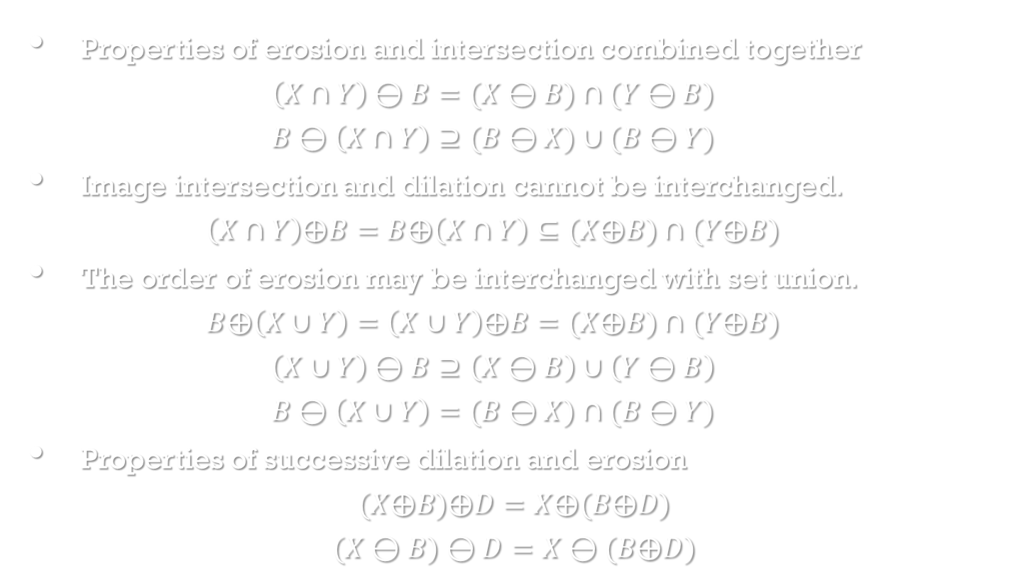
Binary dilation and erosion
Image Processing, Analysis, and Machine Vision, 4th Edition Sonka, Hlavac & Boyle
Properties of erosion and intersection combined together
$$\left(X∩Y\right)⊖B=(X⊖B)∩(Y⊖B)$$
$$B⊖\left(X∩Y\right)⊇(B⊖X)∪(B⊖Y)$$
Image intersection and dilation cannot be interchanged.
$$\left(X∩Y\right)⨁B=B⨁\left(X∩Y\right)⊆(X⨁B)∩(Y⨁B)$$
The order of erosion may be interchanged with set union.
$$B⨁\left(X∪Y\right)=\left(X∪Y\right)⨁B=(X⨁B)∩(Y⨁B)$$
$$\left(X∪Y\right)⊖B⊇\left(X⊖B\right)∪\left(Y⊖B\right)$$
$$B⊖\left(X∪Y\right)=(B⊖X)∩(B⊖Y)$$
Properties of successive dilation and erosion
$$(X⨁B)⨁D=X⨁(B⨁D)$$
$$(X⊖B)⊖D=X⊖(B⨁D)$$

Slide 27
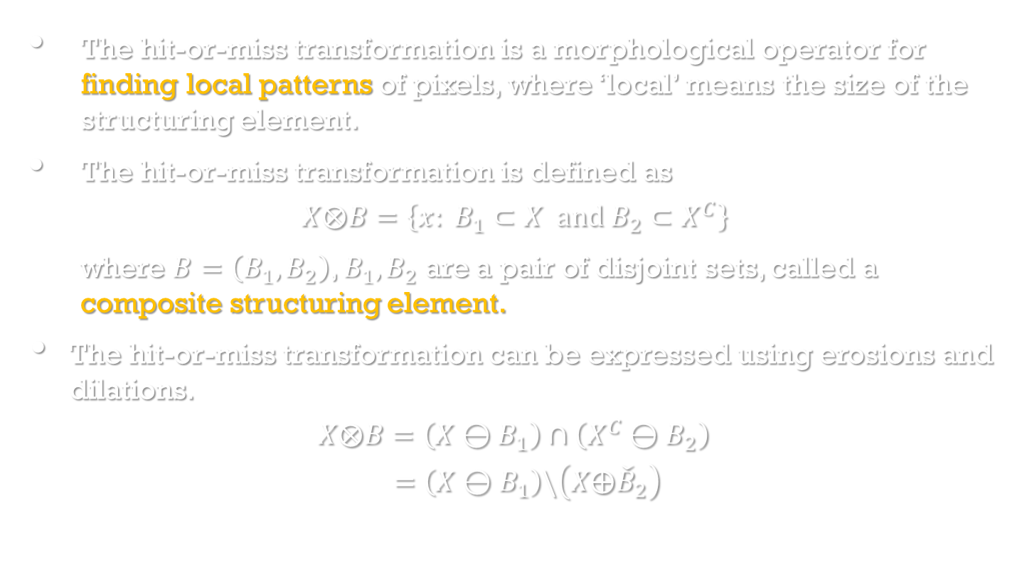
Hit-or-miss transformation
Image Processing, Analysis, and Machine Vision, 4th Edition Sonka, Hlavac & Boyle
The hit-or-miss transformation is a morphological operator for finding local patterns of pixels, where ‘local’ means the size of the structuring element.
The hit-or-miss transformation is defined as
$$X⨂B=\left\{x: B_{1}⊂X and B_{2}⊂X^{C}\right\}$$
where $B=\left(B_{1},B_{2}\right)$, $B_{1},B_{2}$ are a pair of disjoint sets, called a composite structuring element.
The hit-or-miss transformation can be expressed using erosions and dilations.
$$X⨂B=\left(X⊖B_{1}\right)∩\left(X^{C}⊖B_{2}\right)$$
$$=\left(X⊖B_{1}\right)\backslash \left(X⨁{\check{B}}_{2}\right)$$

Slide 28
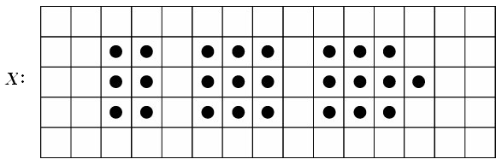
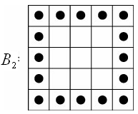
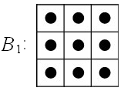









。 Example – find the square in an image
$$X^{C}$$
$$\left(X⊖B_{1}\right)$$
$$\left(X^{C}⊖B_{2}\right)$$
$$X⨂B=\left(X⊖B_{1}\right)∩\left(X^{C}⊖B_{2}\right)$$

Slide 29

Opening and closing
Image Processing, Analysis, and Machine Vision, 4th Edition Sonka, Hlavac & Boyle
Opening
Erosion followed by dilation
$$X∘B=(X⊖B)⨁B$$
If an image $X$ is unchanged by opening with the structuring element $B$, it is called open with respect to $B$.
Closing
Dilation followed by erosion
$$X∙B=(X⨁B) ⊖B$$
If an image $X$ is unchanged by closing with the structuring element $B$, it is called closed with respect to $B$.

Slide 30




Opening
$$X∘B=(X⊖B)⨁B$$
13-30

Slide 31


Closing
$$X∙B=(X⨁B) ⊖B$$
13-31

Slide 32

Opening and closing
Image Processing, Analysis, and Machine Vision, 4th Edition Sonka, Hlavac & Boyle
An example of opening and closing
Opening and closing with an isotropic structuring element is used to eliminate specific image details smaller than the structuring element.
Closing connects objects that are close to each, fills up small holes, and smooths the object outline by filling up narrow gulfs.

Slide 33

Opening and closing
Image Processing, Analysis, and Machine Vision, 4th Edition Sonka, Hlavac & Boyle
Unlike dilation and erosion, opening and closing are invariant to translation of the structuring element.
Both opening and closing are increasing transformation.
Opening is anti-extensive.
$$X∘B⊆X$$
Closing is extensive.
$$X⊆X∙B$$
Opening and closing are dual transformations
$${\left(X∙B\right)}^{C}=X^{C}∘\check{B}$$

Slide 34

Opening and closing
Image Processing, Analysis, and Machine Vision, 4th Edition Sonka, Hlavac & Boyle
Iteratively used openings and closings are idempotent.
It means that reapplication of these transformations does not change the previous result.
$$X∘B=(X∘B)∘B$$
$$X∙B=(X∙B)∙B$$

